Slide 1

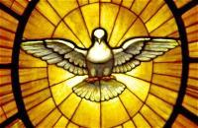
Memory Work, Unit 20
CCM-Schola Rosa Edition

Slide 2

Religion
Q: What are the chief marks of the Church
A: The chief marks of the Church are four: It is one, holy, catholic, and apostolic.
ONE ~HOLY ~CATHOLIC ~APOSTOLIC

Slide 3
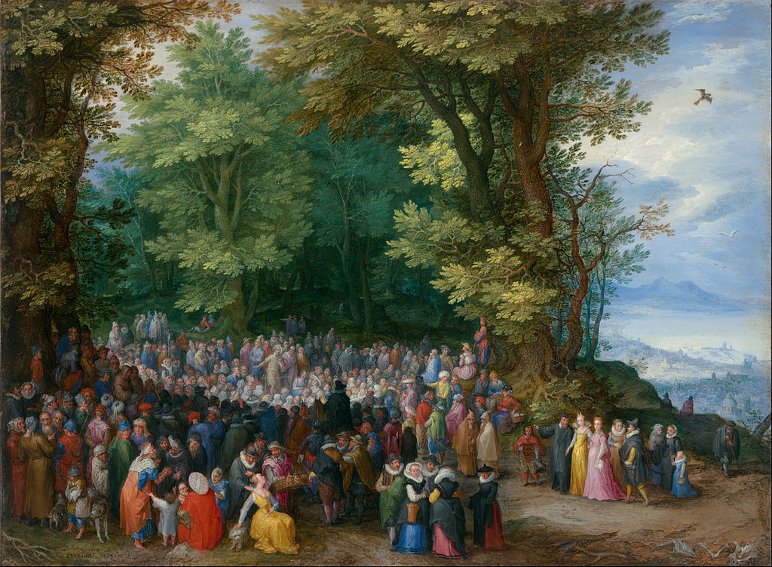
Scripture
Matthew 5: 3-5
Blessed are the poor in spirit, for theirs is the kingdom of heaven. Blessed are those who mourn, for they shall be comforted. Blessed are the meek, for they shall inherit the earth.

Slide 4
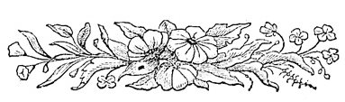
Latin
Adveniat regnum tuum. Fiat voluntas tua,

Slide 5
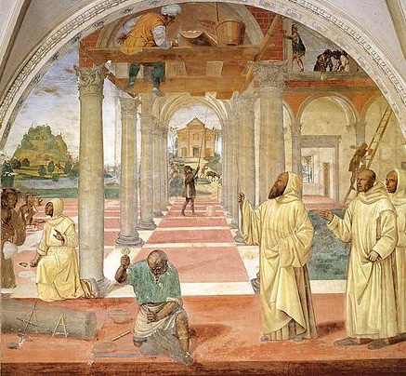
History
During the Middle Ages, monasteries became the centers of learning. The literature of ancient Greece and Rome was protected and preserved in the monasteries, and many works were copied by hand. Saint Benedict developed one of the rules to govern monasteries.

Slide 6
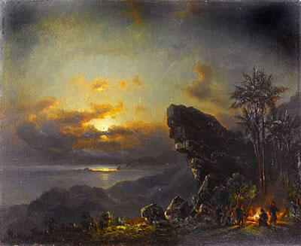
Science
Q: What are the five layers of the earth’s atmosphere
A: Troposphere, Stratosphere, Mesosphere, Thermosphere, Exosphere

Slide 7

Math
^{Multiples of Twelve:}
12, 24, 36, 48, 60, 72, 84, 96, 108, 120, 132, 144

Slide 8
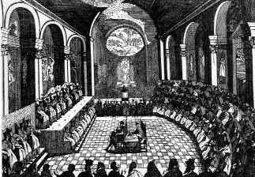
Timeline
Ottoman Turks Capture
Constantinople:1453
Gutenberg and the Printing Press
The Renaissance
Muslims Driven out of Spain
Columbus Discovers America: 1492
Martin Luther and the Reformation
The Council of Trent
Da Gama and Magellan Sail

Slide 9
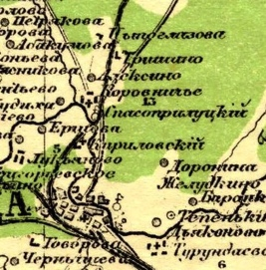
Map 2
Hungary
Belarus
Ukraine
Moldova
Russia
Moscow
Caspian Sea

Slide 10
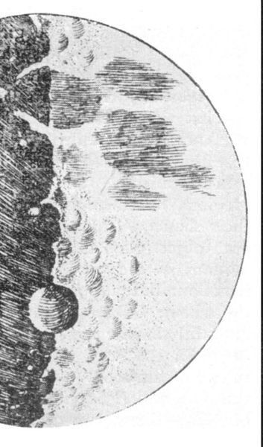
Great Words I
“The Moon” by Robert Louis Stevenson
The squalling cat and the squeaking mouse, The howling dog by the door of the house, The bat that lies in bed at noon,
All love to be out by the light of the moon.

Slide 11
Great Words II
From “Dedication — The Ballad of Whitehorse” By G.K. Chesterton
O go you onward; where you are Shall honour and laughter be,
Past purpled forest and pearled foam, God’s winged pavilion free to roam, Your face, that is a wandering home, A flying home for me.
Ride through the silent earthquake lands, Wide as a waste is wide,
Across these days like deserts, when Pride and a little scratching pen
Have dried and split the hearts of men, Heart of the heroes, ride.

