Slide 1
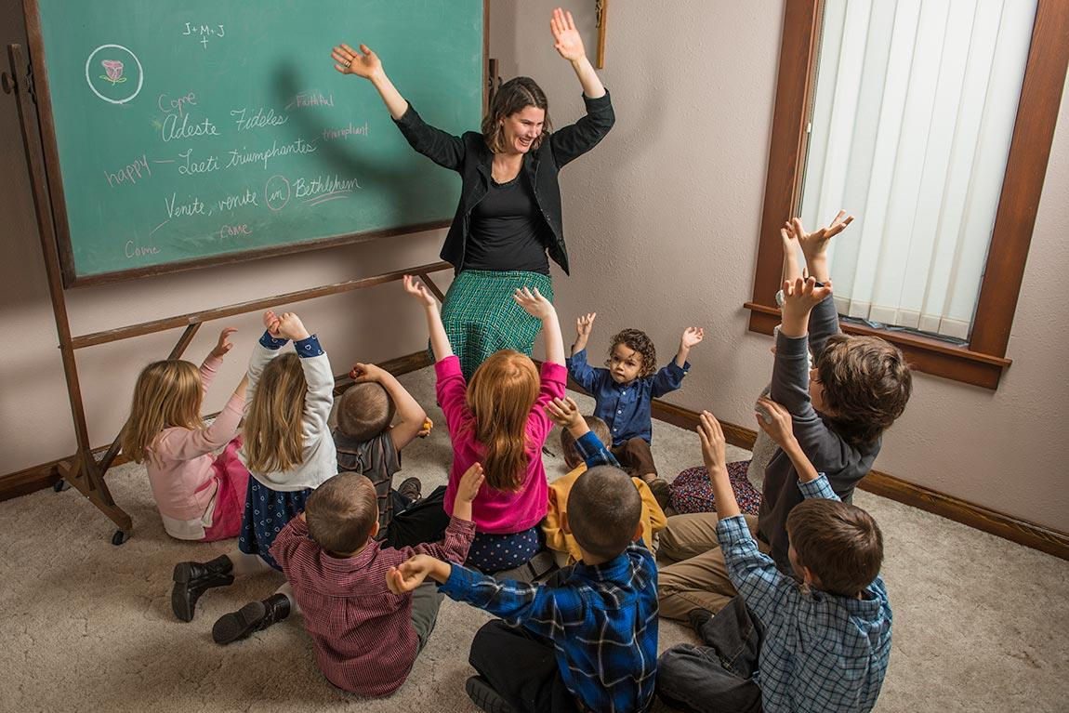
Schola Rosa: Co-op & Home Curriculum

Slide 2


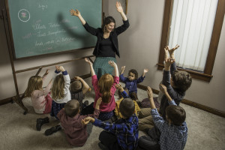
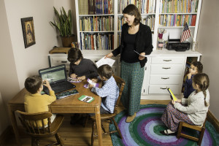
OUR MISSION
Classical Education at Your Fingertips | True to the Magisterium
Local Community Support Build a homeschool community with support! Year-Long Consultations and Advice. | Free-Fun-Easy Materials for Parents Many, extra materials for free in the curriculum. Materials designed for parents to learn along. Materials delivered in a format that is easy to use.

Slide 3
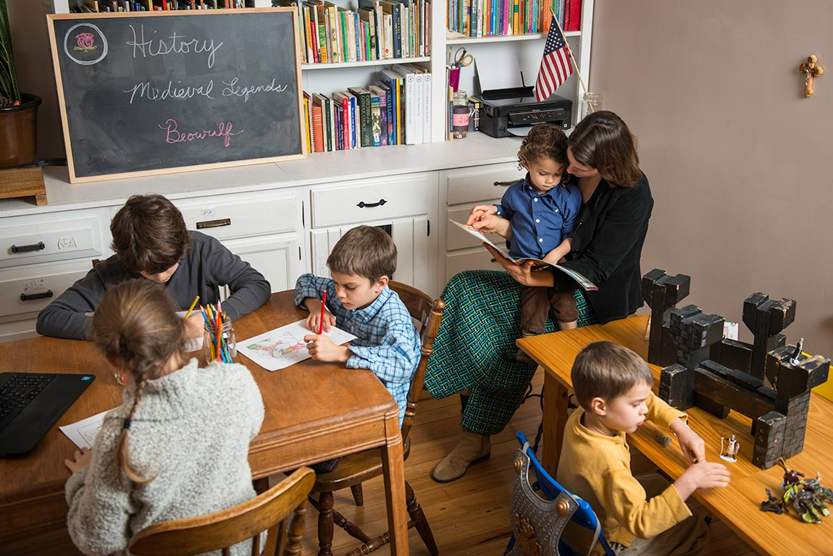
Let’s put your family and co-op on the same page …

Slide 4
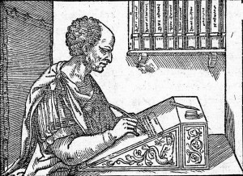
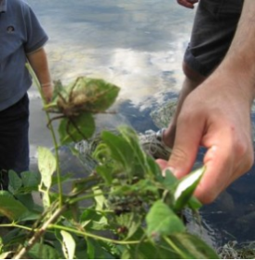
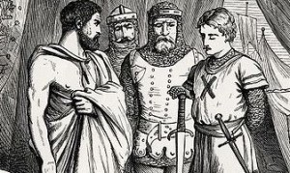
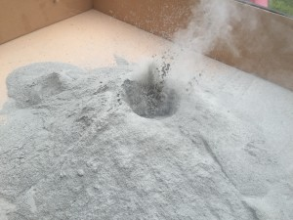
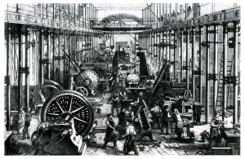
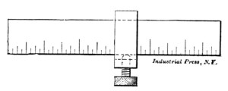
3 Repeating Cycles
Cycle 1 | Ancient & Classical Times | Plant & Animal Life
Cycle 2 | The Christian Age | Earth Science & Astronomy
Cycle 3 | Modern Times & Our America | Chemistry & Physics

Slide 5
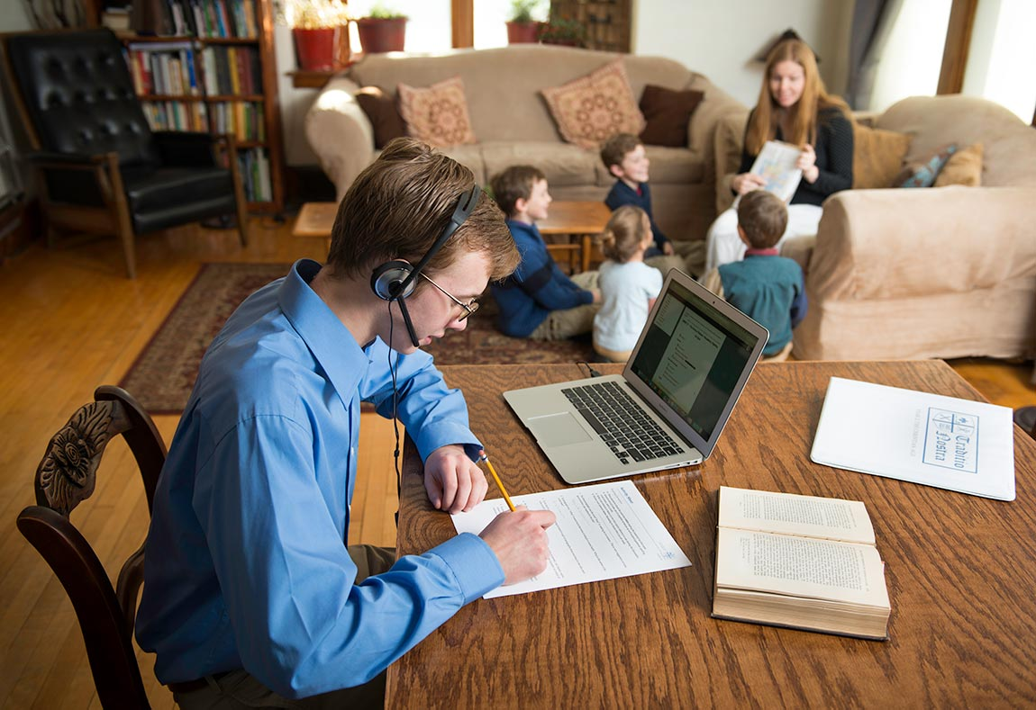
For all levels to make it easier for you …

Slide 6

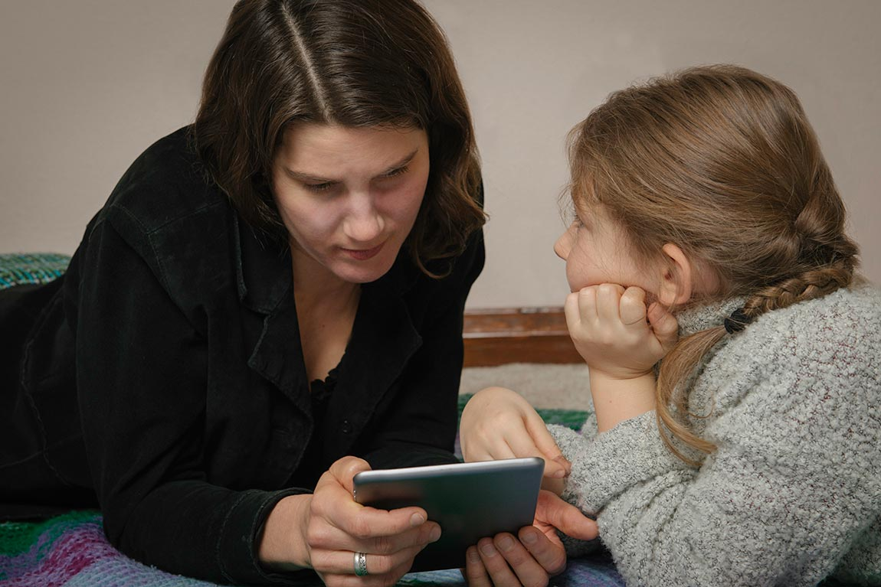
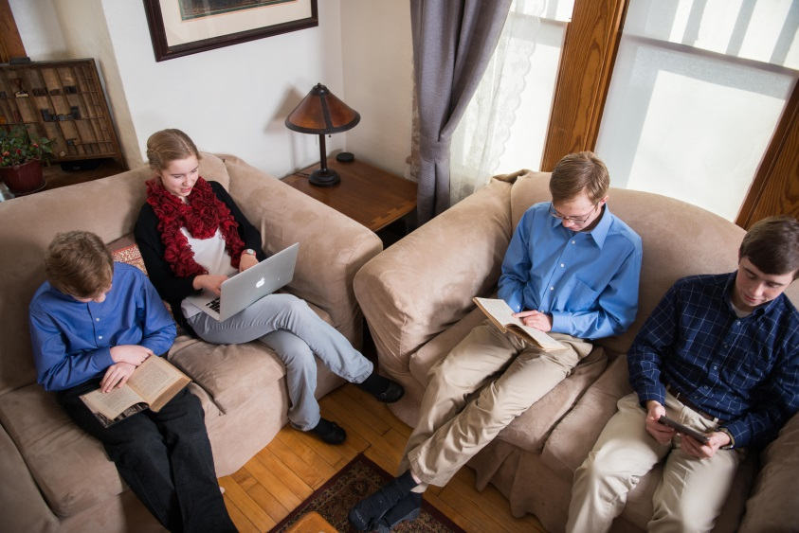
Options Available:
Preschool
K – 6th Grade
7 – 9th Grade
10th – 12th Grade

Slide 7
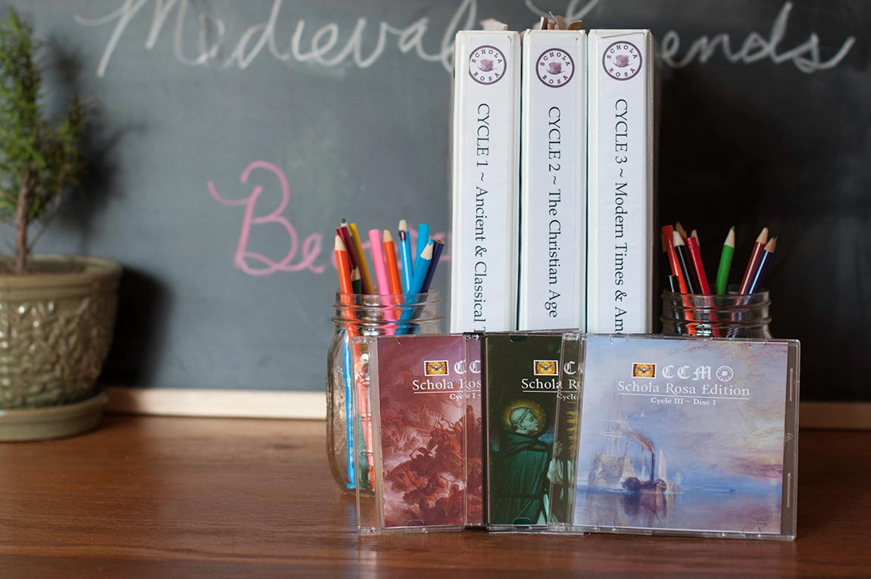
All Subjects in one place, so you don’t have to shop around …

Slide 8

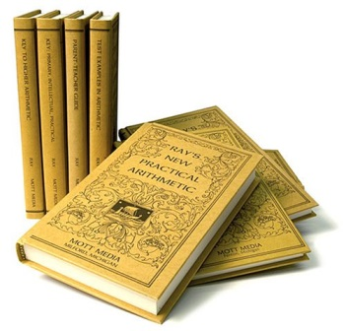

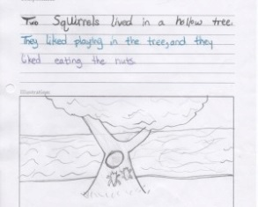
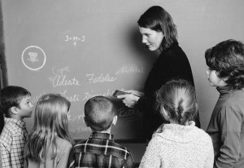

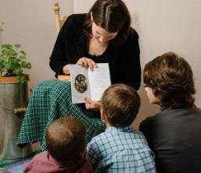
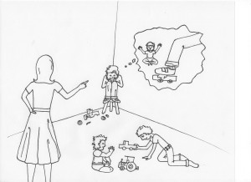
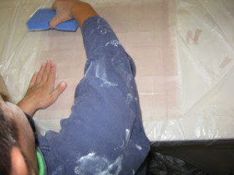

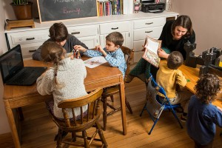

Comprehensive Curriculum
Reading, Writing, & Math
Memory Work
Language Arts
Religion
History, Science, & Virtue
Fine Arts
Preschool

Slide 9


Co-op & Home

Slide 10
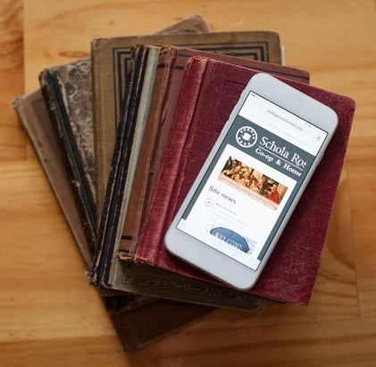
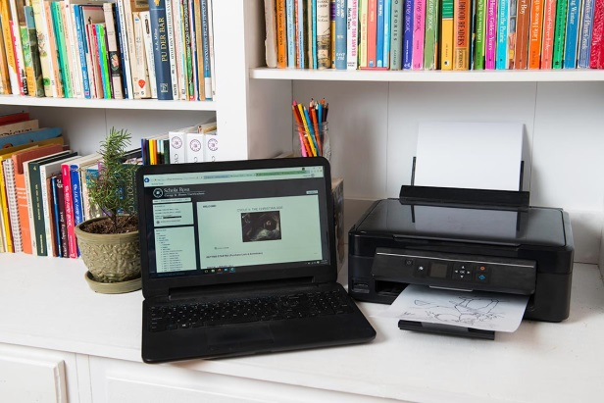
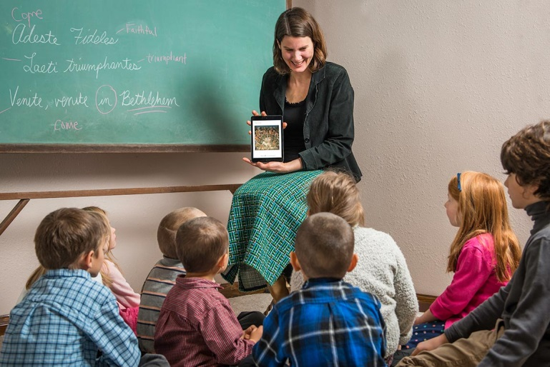
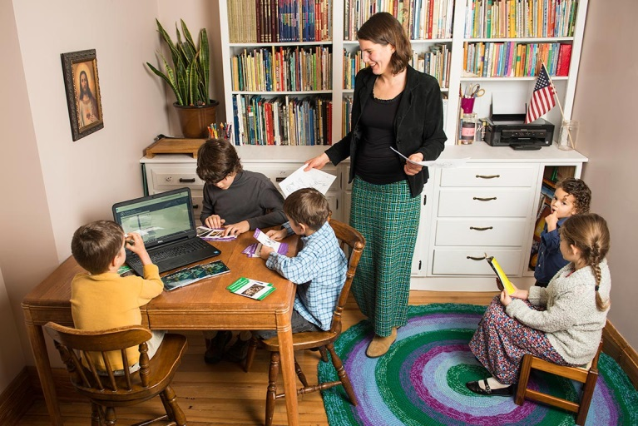
How does it work?
Step 1: Log-In
To view or to Print
OR
Step 2: Teach!
Use your portable device or printed materials.

Slide 11
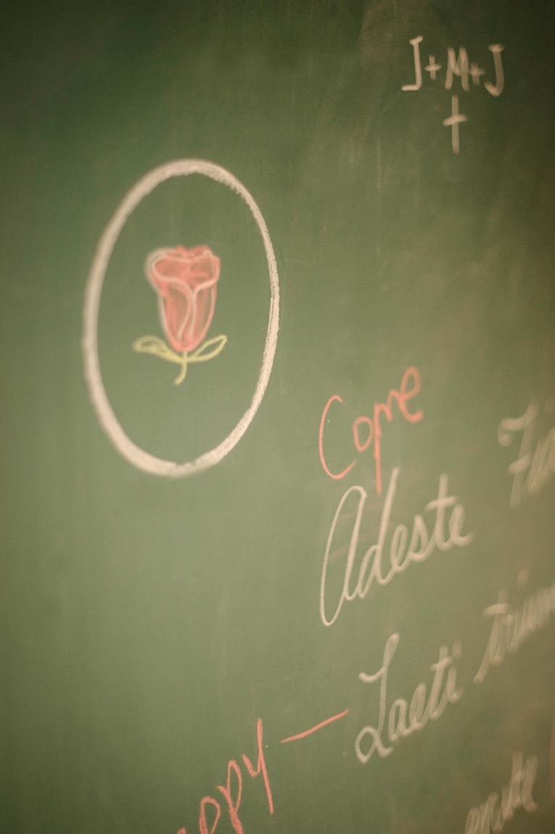
Join our Schola Rosa Community Today!

